Slide 1
Cross-cultural Analysis of Myths
By Scott Stoudt

Slide 2
Research Question
Do myths from different cultures share common themes and characteristics?
Comparative Mythology

Slide 3
Tool Used
Voyant
Used to analyze large amounts of text
Emphasize key words
Individual files
Dataset as a whole

Slide 4
The Dataset
Cultures represented
Egyptian
Chinese
Babylonian/Assyrian
Sumerian
Norse
Mexico/Peru
Hindu
Greek/Roman
Greek/Roman
Iliad
Odyssey
Aeneid
Sumerian
Gilgamesh
‘Large’ set of myths from the other cultures listed

Slide 5
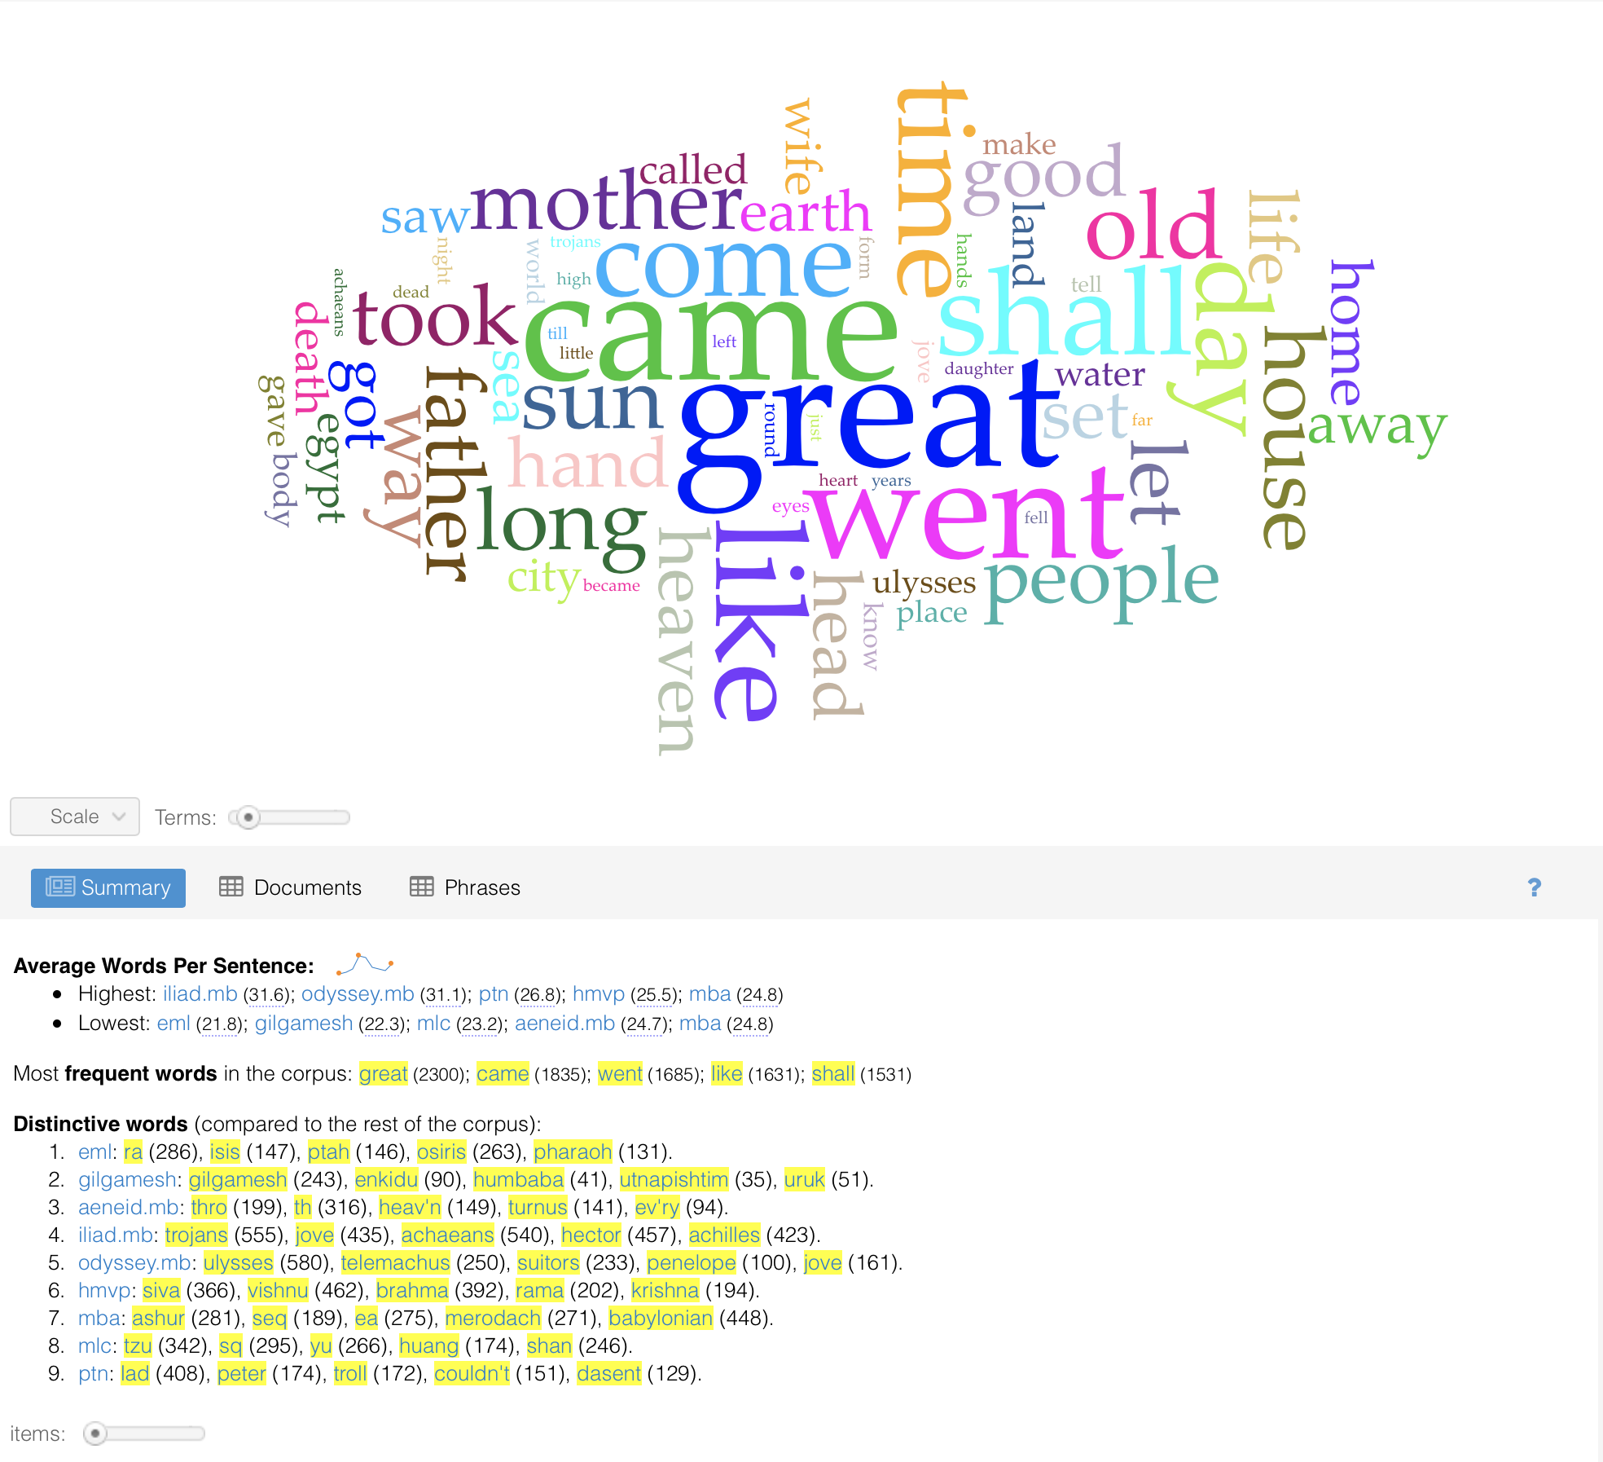
Findings
Whole Dataset
Common words omitted from word cloud:
Son
Man
King
God/goddess
Notes:
Came and Went. Family words.
Suggest journey by a man/son through the world with help from the gods. In search of greatness and/or to protect/reunite with family.
Culture specific words came up a lot. Without reading or prior knowledge of the culture, it is impossible to tell if they connect to anything else.

Slide 6
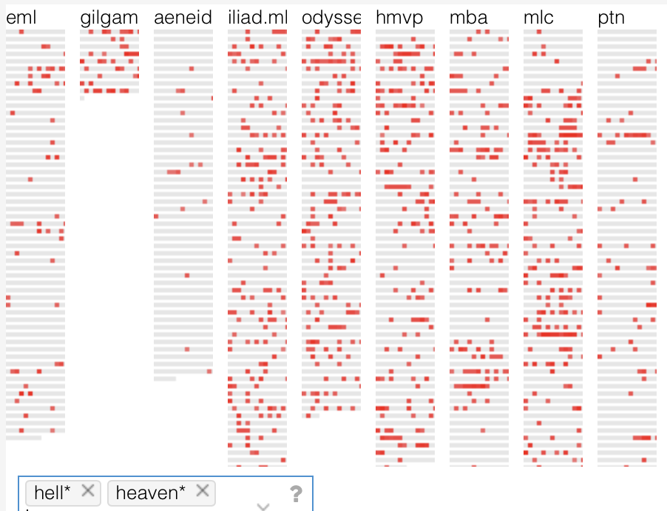
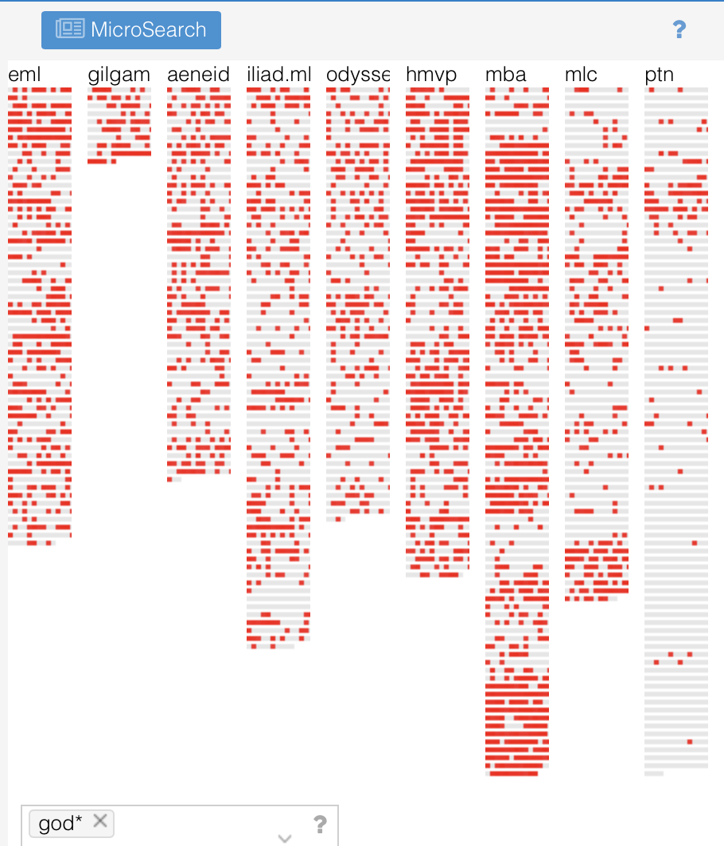
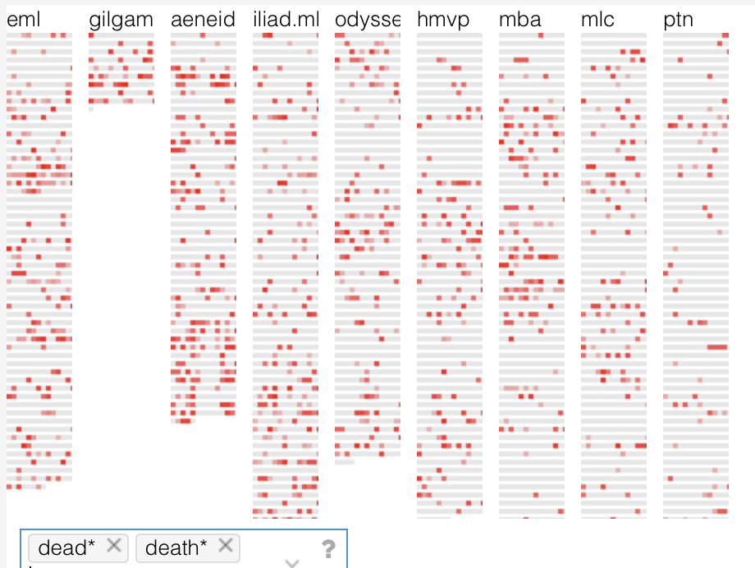
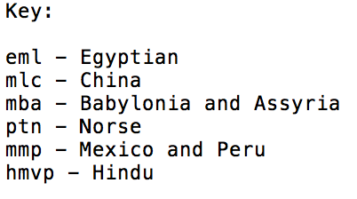
Notes:
Heaven and Hell: prominent in most cultures’ myths
Mentioned less in Aeneid?
God not referenced much in Norse myths. Just this set of myths? Or did the stories center more around the hero?
Dead a key component of most myths, less in certain cultures.

Slide 7
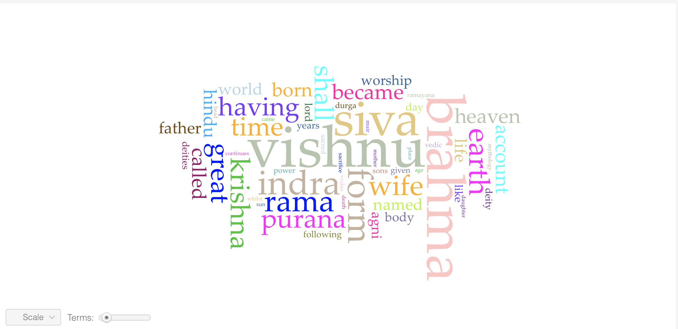
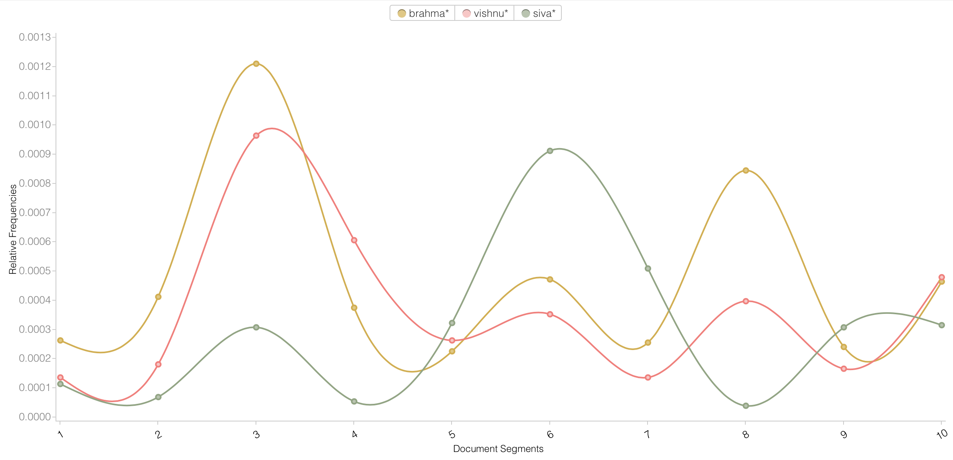
Closer Look: Hindu Myths
Note: The Trinity of Supreme Divinity
Brahma – creator
Vishnu – preserver/protector
Siva (Shiva) – destroyer/regenerator
Notes:
Words tend to be more natural: born, body, life, time
Mention of the Trinity fades in and out of the story’s: Usually appear together.

Slide 8
Difficulties/Final Thoughts
Dataset
Size- Nowhere near large enough
Integrity- Hard to know how complete the data is
Translation conflicts
Tool
Voyant by itself isn’t enough to draw concrete conclusions
More advanced text analysis tools are needed

Slide 9
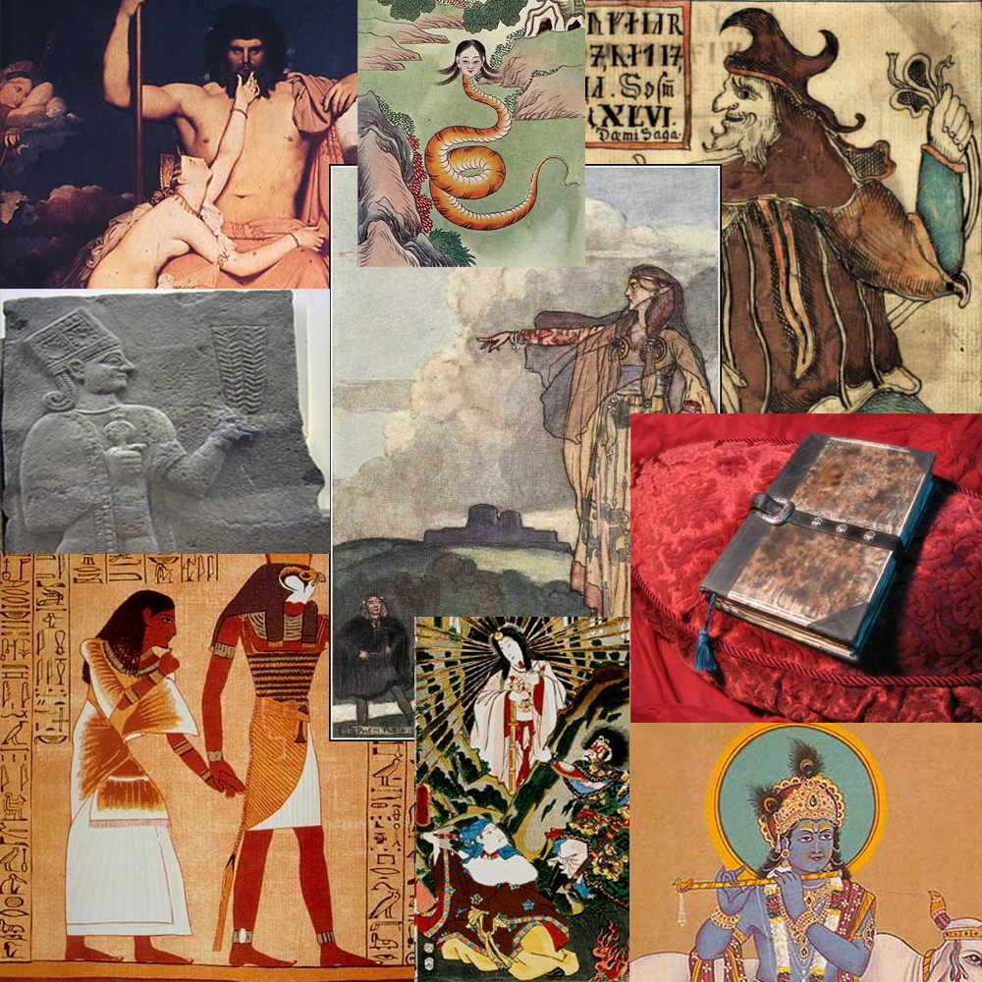
Questions?

